Slide 1
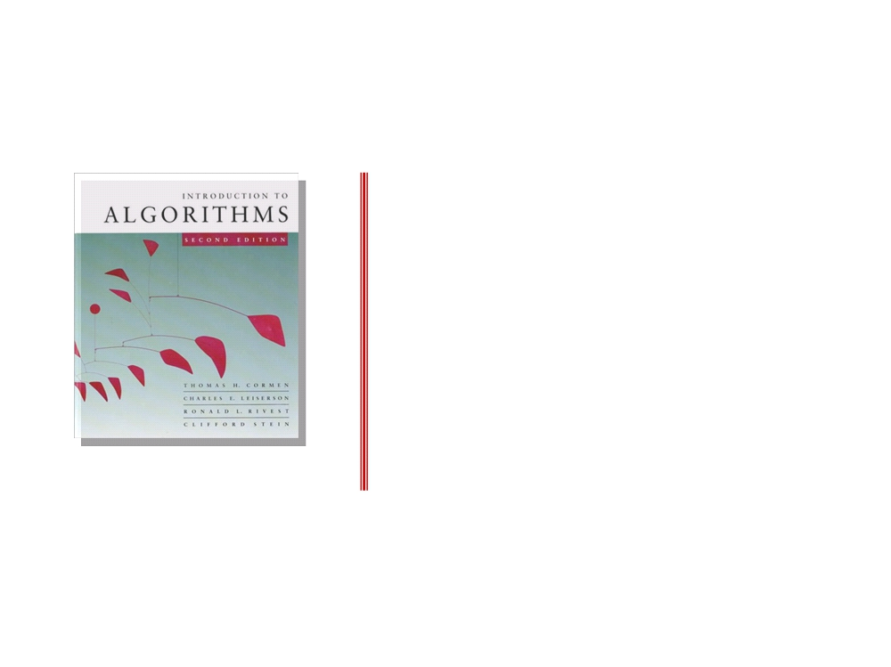
Introduction to Algorithms
LECTURE 1
Analysis of Algorithms
• Insertion sort
• Asymptotic analysis
• Merge sort
• Recurrences

Slide 2

Course information
Staff
Dr basheer Youssef
2. Lectures two lec per week + one lab
3. Textbook
Introduction to Algorithms second edition . Thomas H.Cormen
+ Foundations of Algorithms Using C++ Pseudocode
4-Grading policy
15 midterm 15 Three assignments
5 labs 5 two Quizzes
Introduction to Algorithms
L1.2

Slide 3
Analysis of algorithms
The theoretical study of computer-program
performance and resource usage.
What’s more important than performance?
• modularity
• correctness
• user-friendliness
• programmer time
• simplicity
• maintainability
• functionality
• robustness
• extensibility
• reliability
feb 13, 2012
Introduction to Algorithms
L1.3

Slide 4
Why study algorithms and
performance?
• Algorithms help us to understand scalability.
• Performance often draws the line between what
is feasible and what is impossible.
• Algorithmic mathematics provides a language
for talking about program behavior.
• Performance is the currency of computing.
• The lessons of program performance generalize
to other computing resources.
• Speed is fun!
feb 13, 2012
Introduction to Algorithms
L1.4

Slide 5
The problem of sorting
Input: sequence 〈a1, a2, …, an〉 of numbers.
Output: permutation 〈a'1, a'2, …, a'n〉 such
that a'1 ≤ a'2 ≤ … ≤ a'n .
Example:
Input: 8 2 4 9 3 6
Output: 2 3 4 6 8 9
feb 13, 2012
Introduction to Algorithms
L1.5

Slide 6

Insertion sort
INSERTION-SORT (A, n)⊳ A[1 . . n ]
for j ← 2 to n
do key ← A[ j]
“pseudocode”
i ← j - 1
while i > 0 and A[i] > key
do A[i+1] ← A[i]
i ← i - 1
A[i+1] = key
feb 13, 2012
Introduction to Algorithms
L1.6

Slide 7
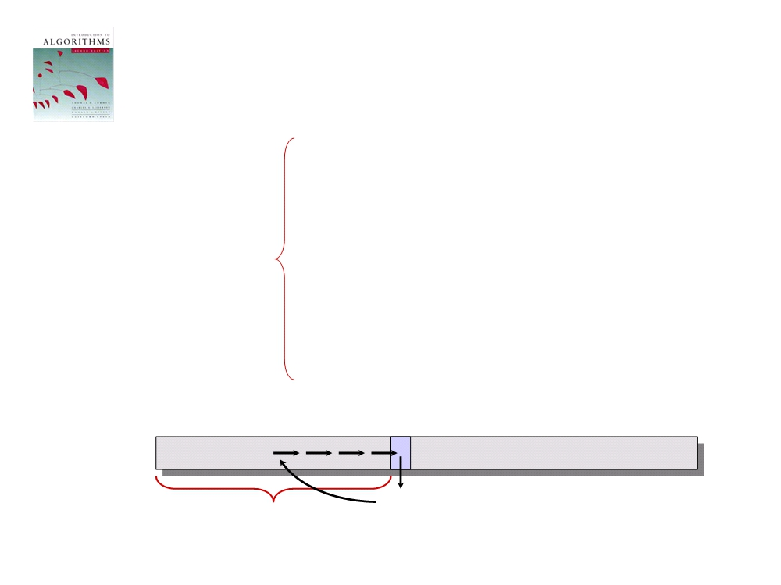
Insertion sort
INSERTION-SORT (A, n) ⊳ A[1 . . n]
for j ← 2 to n
do key ← A [ j]
“pseudocode”
i ← j - 1
while i > 0 and A[i] > key
do A[i+1] ←A[ i]
i ← i - 1
A[i+1] = key
j n
1 i
A:
key
sorted
feb 13, 2012
Introduction to Algorithms
L1.7

Slide 8
Example of insertion sort
8
2
4
9
3
6
feb 13, 2012
Introduction to Algorithms
L1.8

Slide 9
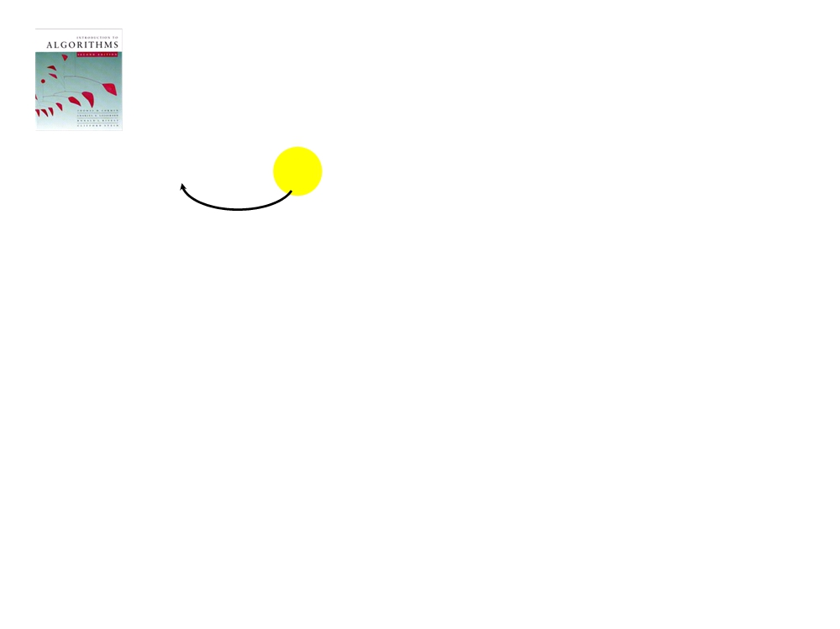
Example of insertion sort
8
2
4
9
3
6
feb 13, 2012
Introduction to Algorithms
L1.9

Slide 10
Example of insertion sort
8
2
4
9
3
6
2
8
4
9
3
6
feb 13, 2012
Introduction to Algorithms
L1.10

Slide 11
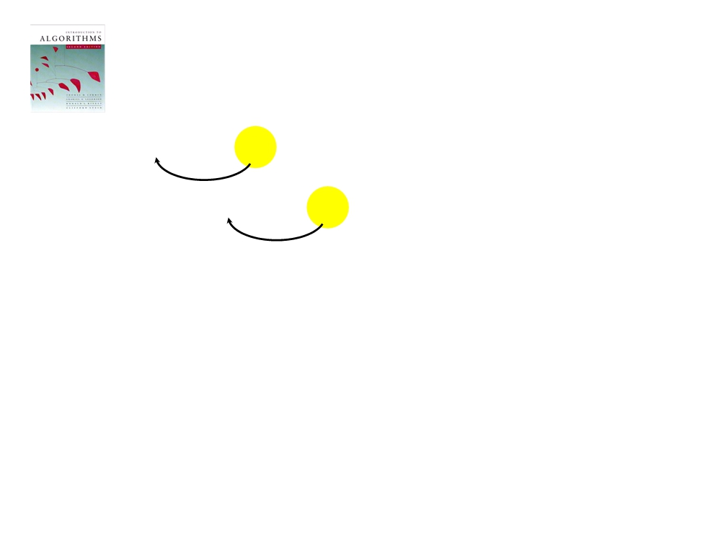
Example of insertion sort
8
2
4
9
3
6
2
8
4
9
3
6
feb 13, 2012
Introduction to Algorithms
L1.11

Slide 12
Example of insertion sort
8
2
4
9
3
6
2
8
4
9
3
6
2
4
8
9
3
6
feb 13, 2012
Introduction to Algorithms
L1.12

Slide 13
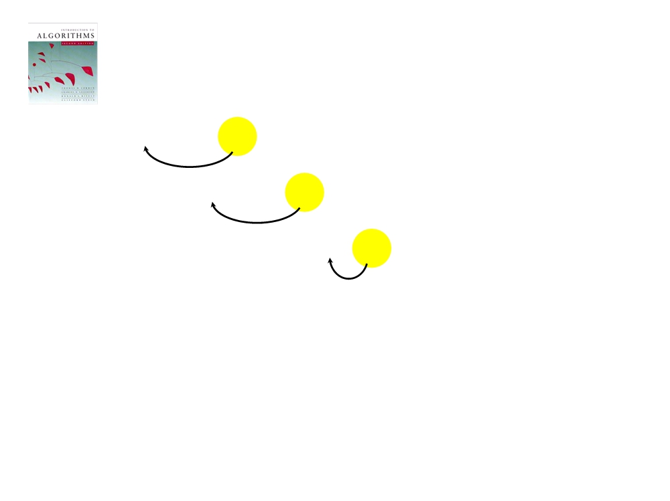
Example of insertion sort
8
2
4
9
3
6
2
8
4
9
3
6
2
4
8
9
3
6
feb 13, 2012
Introduction to Algorithms
L1.13

Slide 14
Example of insertion sort
8
2
4
9
3
6
2
8
4
9
3
6
2
4
8
9
3
6
2
4
8
9
3
6
feb 13, 2012
Introduction to Algorithms
L1.14

Slide 15
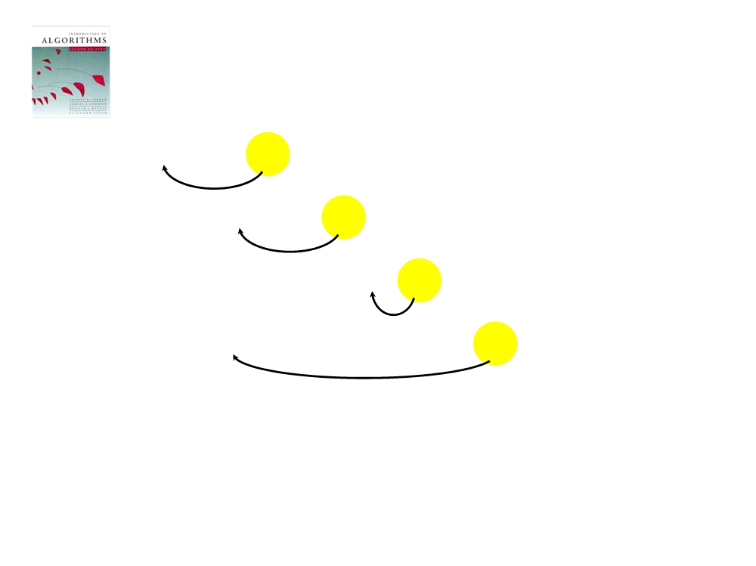
Example of insertion sort
8
2
4
9
3
6
2
8
4
9
3
6
2
4
8
9
3
6
2
4
8
9
3
6
feb 13, 2012
Introduction to Algorithms
L1.15

Slide 16
Example of insertion sort
8
2
4
9
3
6
2
8
4
9
3
6
2
4
8
9
3
6
2
4
8
9
3
6
2
3
4
8
9
6
feb 13, 2012
Introduction to Algorithms
L1.16

Slide 17
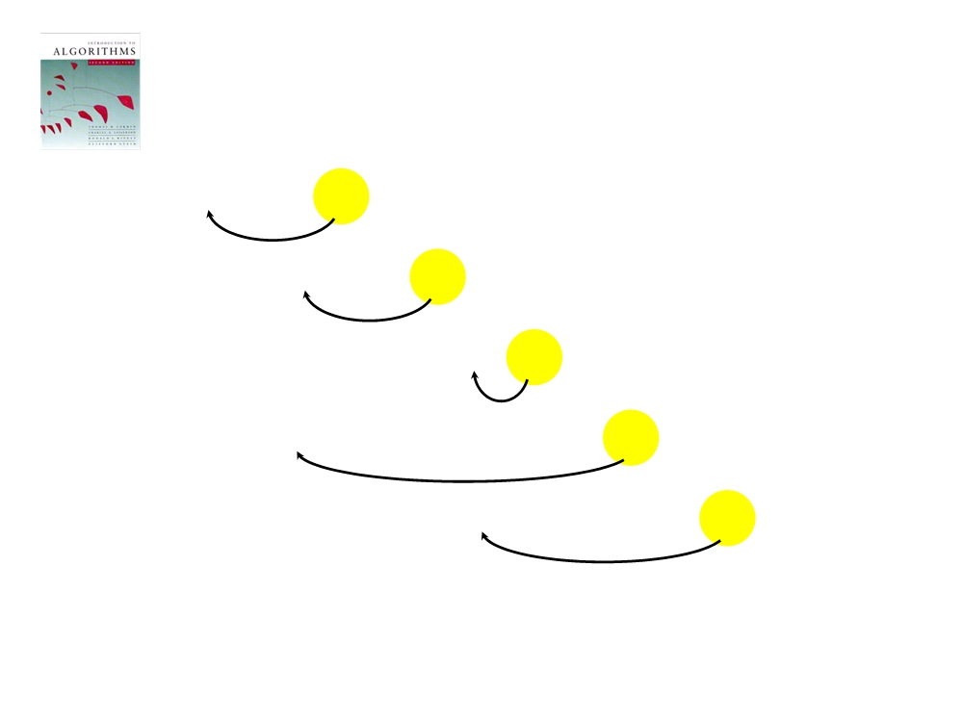
Example of insertion sort
8
2
4
9
3
6
2
8
4
9
3
6
2
4
8
9
3
6
2
4
8
9
3
6
2
3
4
8
9
6
feb 13, 2012
Introduction to Algorithms
L1.17

Slide 18
Example of insertion sort
8
2
4
9
3
6
2
8
4
9
3
6
2
4
8
9
3
6
2
4
8
9
3
6
2
3
4
8
9
6
2
3
4
6
8
9
done
feb 13, 2012
Introduction to Algorithms
L1.18

Slide 19
Running time
• The running time depends on the input: an
already sorted sequence is easier to sort.
• Parameterize the running time by the size of
the input, since short sequences are easier to
sort than long ones.
• Generally, we seek upper bounds on the
running time, because everybody likes a
guarantee.
feb 13, 2012
Introduction to Algorithms
L1.19

Slide 20
Kinds of analyses
Worst-case: (usually)
• T(n) = maximum time of algorithm
on any input of size n.
Average-case: (sometimes)
• T(n) = expected time of algorithm
over all inputs of size n.
• Need assumption of statistical
distribution of inputs.
Best-case: (bogus)
• Cheat with a slow algorithm that
works fast on some input.
feb 13, 2012
Introduction to Algorithms
L1.20

Slide 21
Machine-independent time
What is insertion sort’s worst-case time?
• It depends on the speed of our computer:
• relative speed (on the same machine),
• absolute speed (on different machines).
BIG IDEA:
• Ignore machine-dependent constants.
• Look at growth of T(n) as n → ∞ .
“Asymptotic (Near to real) Analysis”
feb 13, 2012
Introduction to Algorithms
L1.21

Slide 22
Θ-notation
Math:
Θ(g(n)) = { f (n) : there exist positive constants c1, c2, and
n0 such that 0 ≤ c1 g(n) ≤ f (n) ≤ c2 g(n)
for all n ≥ n0 }
Engineering:
• Drop low-order terms; ignore leading constants.
• Example: 3n³ + 90n² - 5n + 6046 = Θ(n³)
feb 13, 2012
Introduction to Algorithms
L1.22

Slide 23
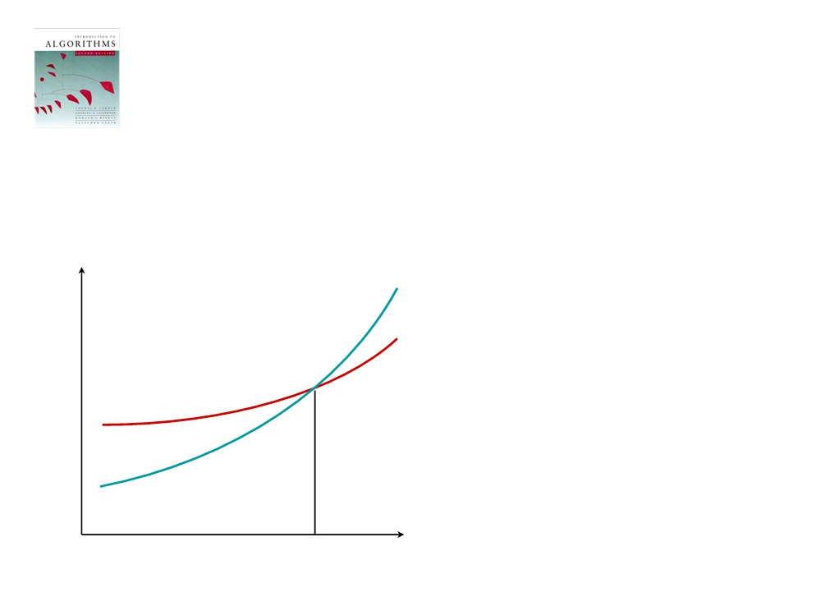
Asymptotic performance
When n gets large enough, a Θ(n²) algorithm
always beats a Θ(n³) algorithm.
• We shouldn’t ignore
asymptotically slower
algorithms, however.
• Real-world design
situations often call for a
T(n)
careful balancing of
engineering objectives.
• Asymptotic analysis is a
useful tool to help to
structure our thinking.
n
n0
feb 13, 2012
Introduction to Algorithms
L1.23

Slide 24
Insertion sort analysis
Worst case: Input reverse sorted.
n
T(n)=
∑
2
[arithmetic series]
Θ(j)=Θ(n )
j=2
Average case: All permutations equally likely.
n
T(n)=
∑
2
Θ(j / 2)=Θ(n )
j=2
Is insertion sort a fast sorting algorithm?
• Moderately so, for small n.
• Not at all, for large n.
feb 13, 2012
Introduction to Algorithms
L1.24

Slide 25
Recursion first
Merge sort
MERGE-SORT A[1 . . n]
1. If n = 1, done.
2. Recursively sort A[ 1 . . ⎡n/2⎤ ]
and A [ ⎡n/2 ⎤+1 . . n ] .
3. “Merge” the 2 sorted lists.
Key subroutine: MERGE
feb 13, 2012
Introduction to Algorithms
L1.25

Slide 26

Merging two sorted arrays
20
12
13
11
7
9
2
1
feb 13, 2012
Introduction to Algorithms
L1.26

Slide 27
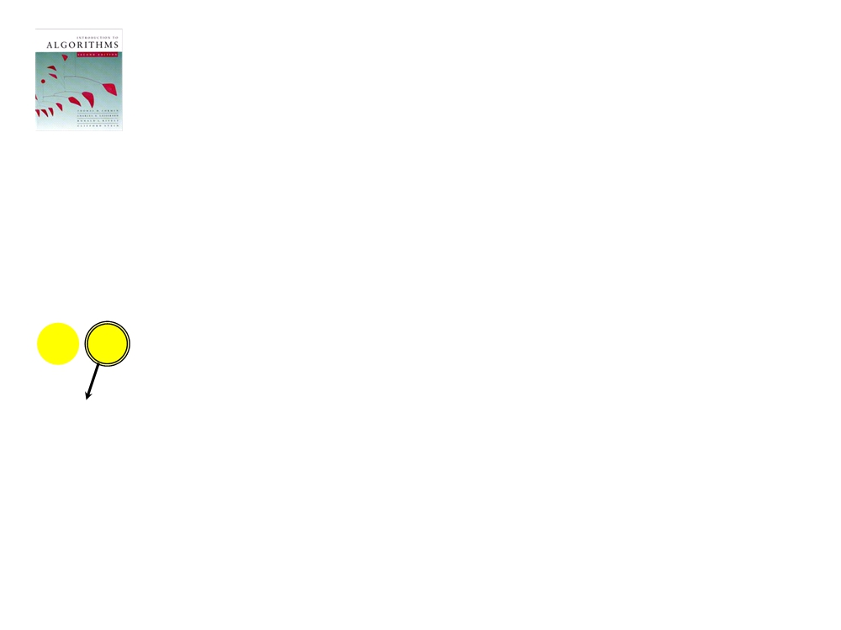
Merging two sorted arrays
20
12
13
11
7
9
2
1
1
feb 13, 2012
Introduction to Algorithms
L1.27

Slide 28
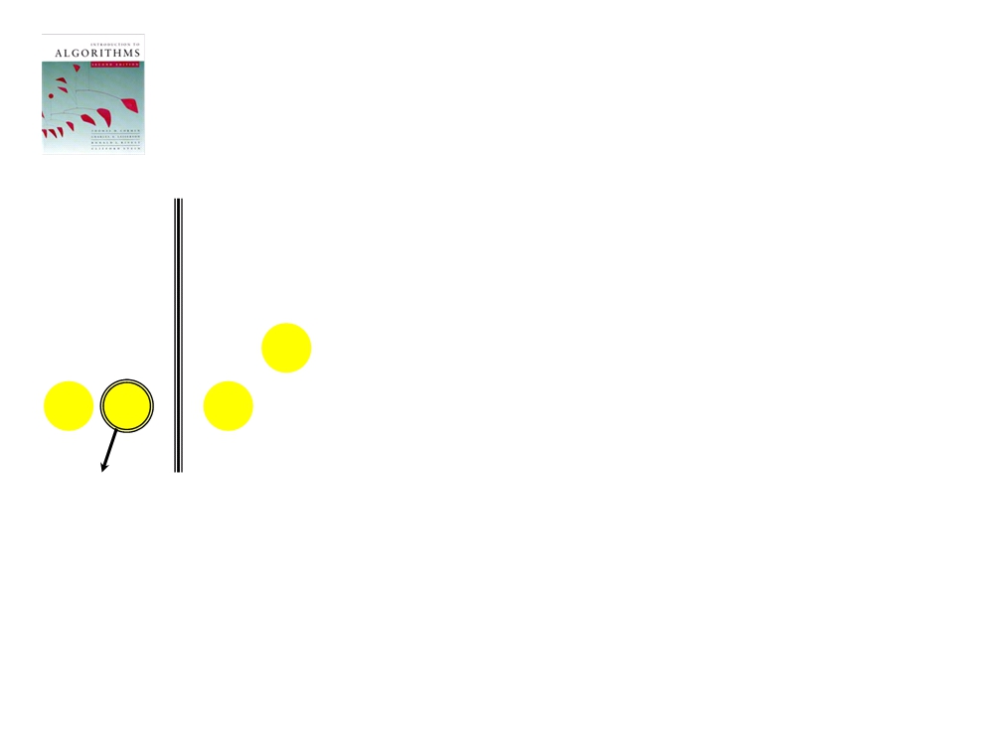
Merging two sorted arrays
20
12
20
12
13
11
13
11
7
9
7
9
2
1
2
1
feb 13, 2012
Introduction to Algorithms
L1.28

Slide 29
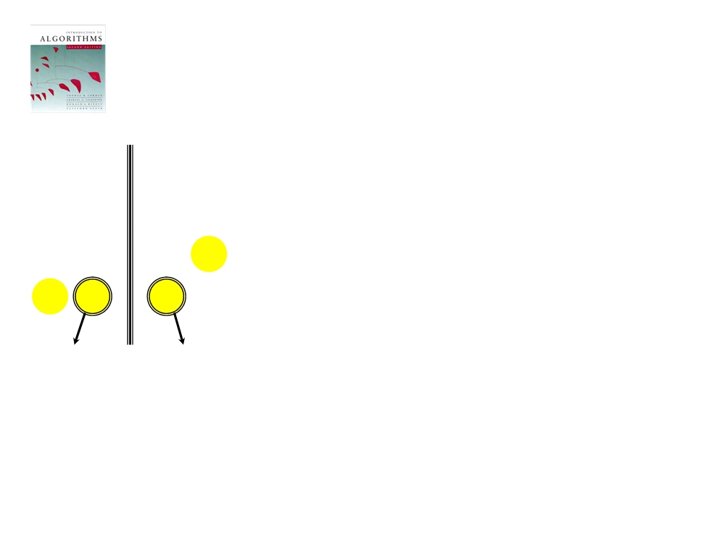
Merging two sorted arrays
20
12
20
12
13
11
13
11
7
9
7
9
2
1
2
1
2
feb 13, 2012
Introduction to Algorithms
L1.29

Slide 30
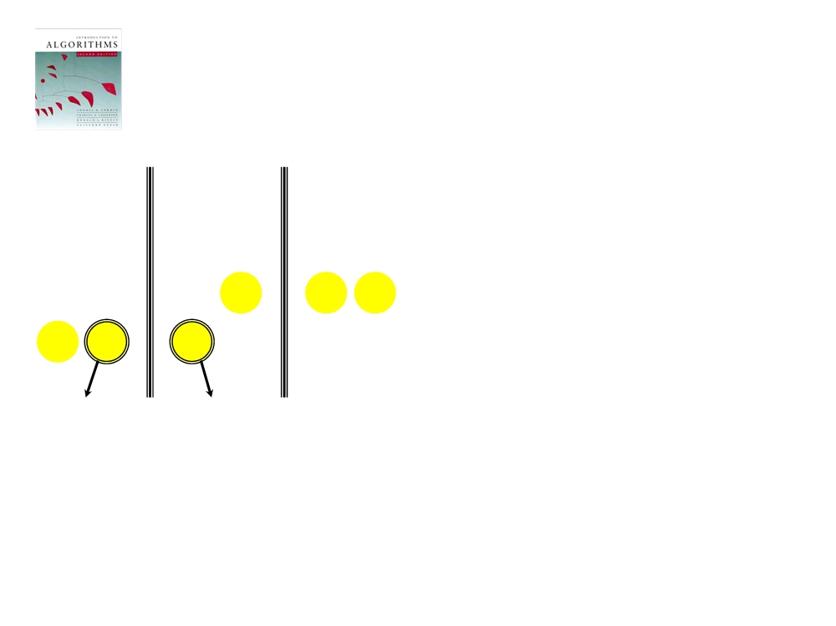
Merging two sorted arrays
20
12
20
12
20
12
13
11
13
11
13
11
7
9
7
9
7
9
2
1
2
1
2
feb 13, 2012
Introduction to Algorithms
L1.30

Slide 31
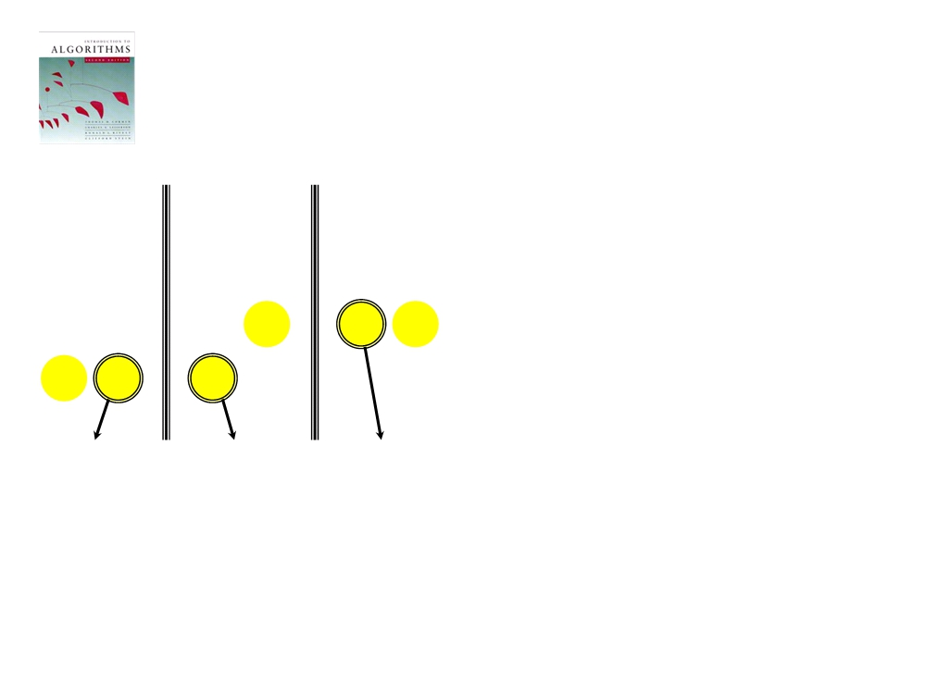
Merging two sorted arrays
20
12
20
12
20
12
13
11
13
11
13
11
7
9
7
9
7
9
2
1
2
1
2
7
feb 13, 2012
Introduction to Algorithms
L1.31

Slide 32
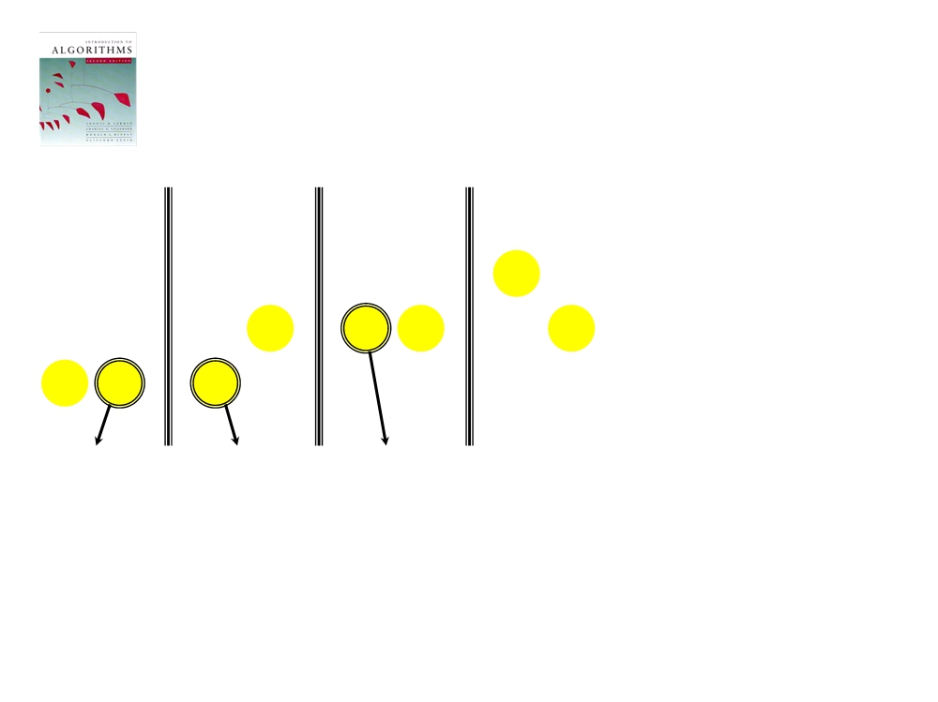
Merging two sorted arrays
20
12
20
12
20
12
20
12
13
11
13
11
13
11
13
11
7
9
7
9
7
9
9
2
1
2
1
2
7
feb 13, 2012
Introduction to Algorithms
L1.32

Slide 33
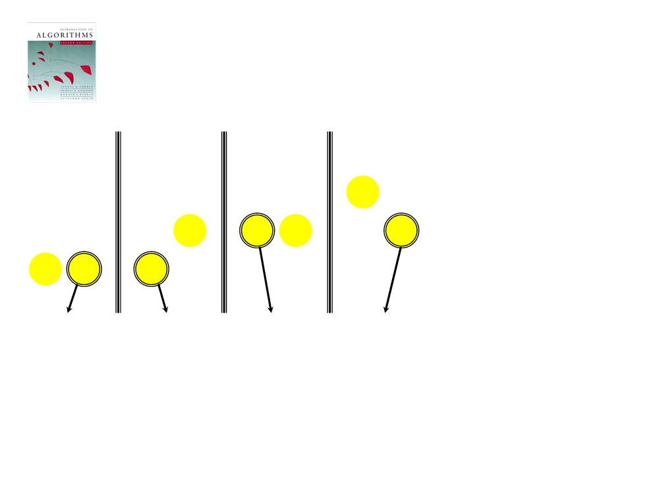
Merging two sorted arrays
20
12
20
12
20
12
20
12
13
11
13
11
13
11
13
11
7
9
7
9
7
9
9
2
1
2
1
2
7
9
feb 13, 2012
Introduction to Algorithms
L1.33

Slide 34
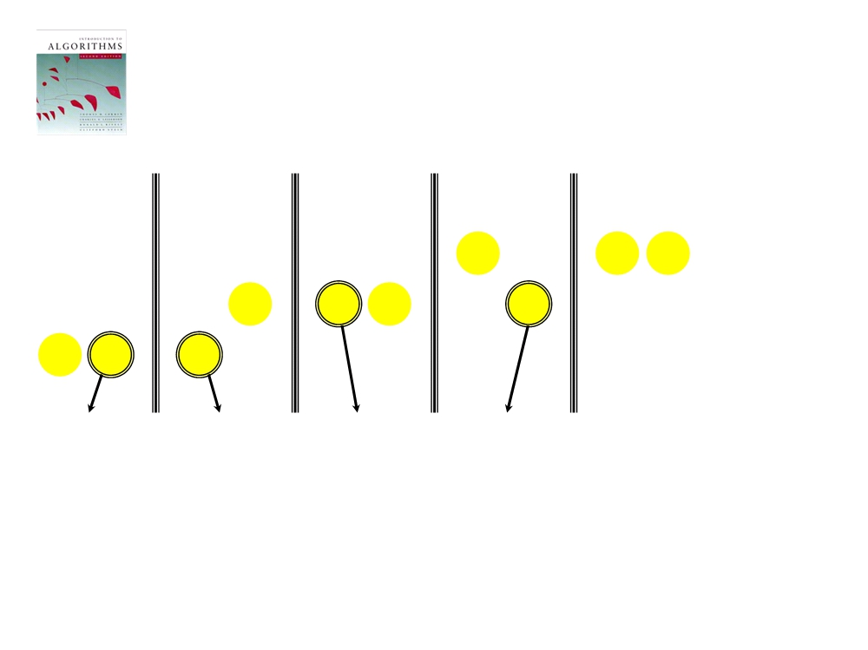
Merging two sorted arrays
20
12
20
12
20
12
20
12
20
12
13
11
13
11
13
11
13
11
13
11
7
9
7
9
7
9
9
2
1
2
1
2
7
9
feb 13, 2012
Introduction to Algorithms
L1.34

Slide 35
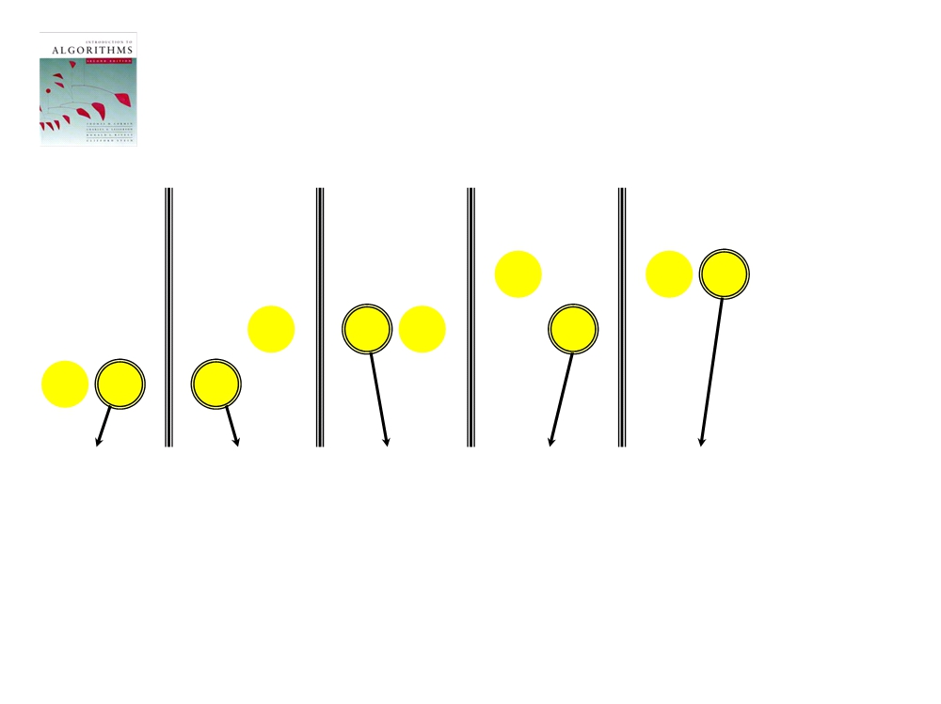
Merging two sorted arrays
20
12
20
12
20
12
20
12
20
12
13
11
13
11
13
11
13
11
13
11
7
9
7
9
7
9
9
2
1
2
1
2
7
9
11
feb 13, 2012
Introduction to Algorithms
L1.35

Slide 36
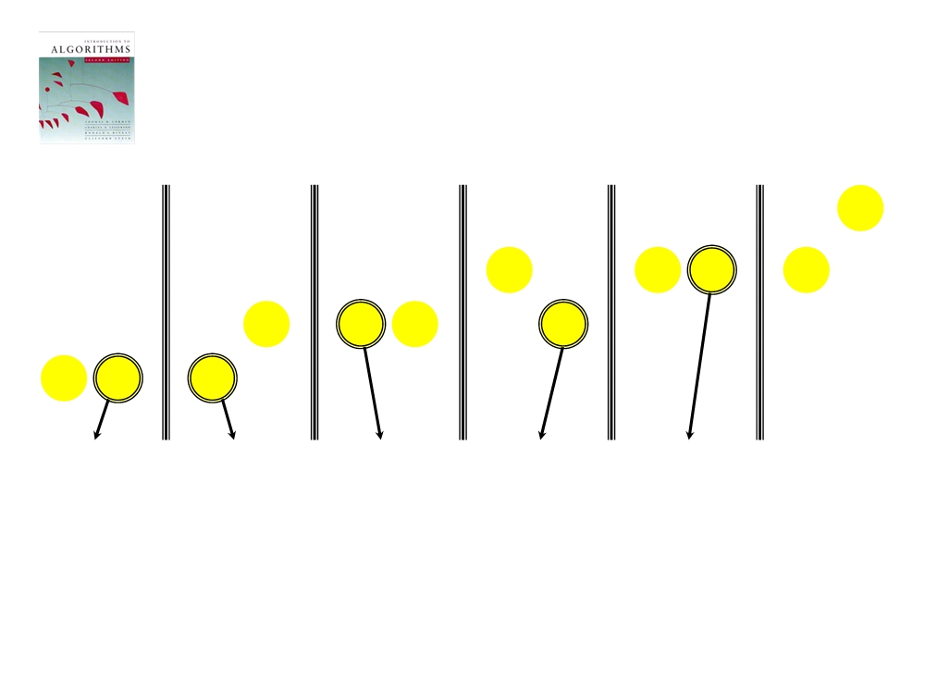
Merging two sorted arrays
20
12
20
12
20
12
20
12
20
12
20
12
13
11
13
11
13
11
13
11
13
11
13
7
9
7
9
7
9
9
2
1
2
1
2
7
9
11
feb 13, 2012
Introduction to Algorithms
L1.36

Slide 37
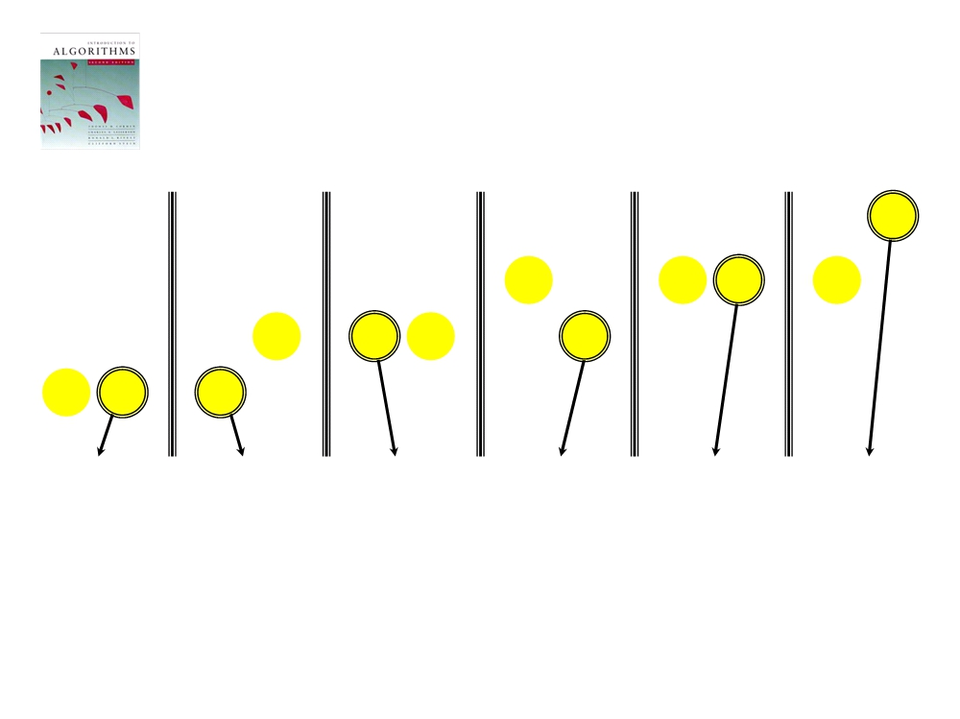
Merging two sorted arrays
20
12
20
12
20
12
20
12
20
12
20
12
13
11
13
11
13
11
13
11
13
11
13
7
9
7
9
7
9
9
2
1
2
1
2
7
9
11
12
feb 13, 2012
Introduction to Algorithms
L1.37

Slide 38
Merging two sorted arrays
20
12
20
12
20
12
20
12
20
12
20
12
13
11
13
11
13
11
13
11
13
11
13
7
9
7
9
7
9
9
2
1
2
1
2
7
9
11
12
Time = Θ(n) to merge a total
of n elements (linear time).
feb 13, 2012
Introduction to Algorithms
L1.38

Slide 39

Analyzing merge sort
T(n)
Θ(1)
MERGE-SORT A[1 . . n]
1. If n = 1, done.
2T(n/2)
2. Recursively sort A[ 1 . . ⎡n/2⎤ ]
and A [ ⎡n/2 ⎤+1 . . n ] .
Θ(n)
3. “Merge” the 2 sorted lists
: Should be T( ⎡n/2⎤ ) + T( ⎣n/2⎦ ) ,
but it turns out not to matter asymptotically.
feb 13, 2012
Introduction to Algorithms
L1.39

Slide 40
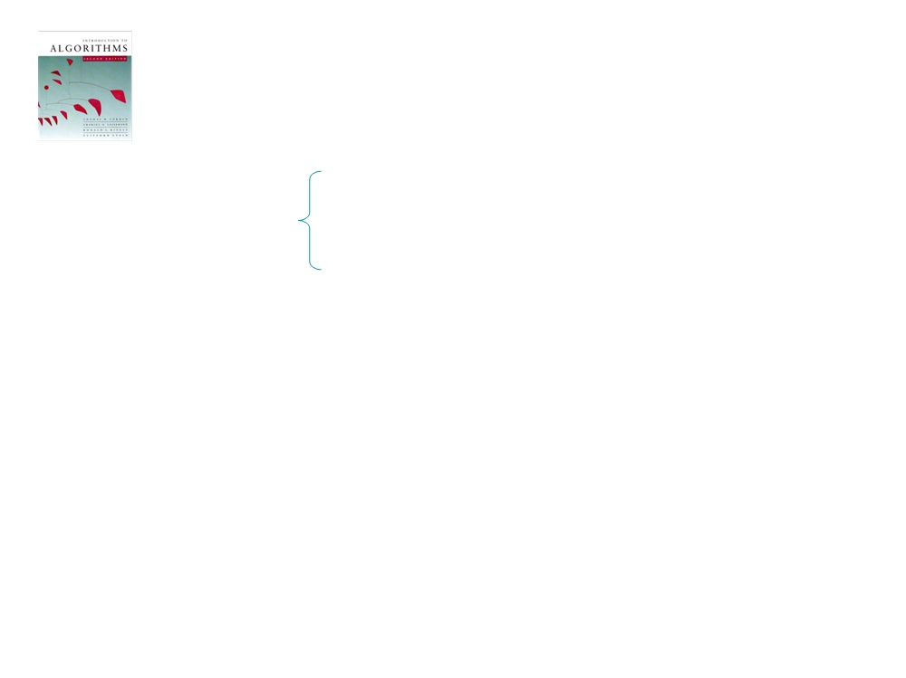
Recurrence for merge sort
T(n) = Θ(1) if n = 1;
2T(n/2) + Θ(n) if n > 1.
• We shall usually omit stating the base
case when T(n) = Θ(1) for sufficiently
small n, but only when it has no effect on
the asymptotic solution to the recurrence.
feb 13, 2012
Introduction to Algorithms
L1.40

Slide 41
Recursion tree
Solve T(n) = 2T(n/2) + cn, where c > 0 is constant.
feb 13, 2012
Introduction to Algorithms
L1.41

Slide 42
Recursion tree
Solve T(n) = 2T(n/2) + cn, where c > 0 is constant.
T(n)
feb 13, 2012
Introduction to Algorithms
L1.42

Slide 43
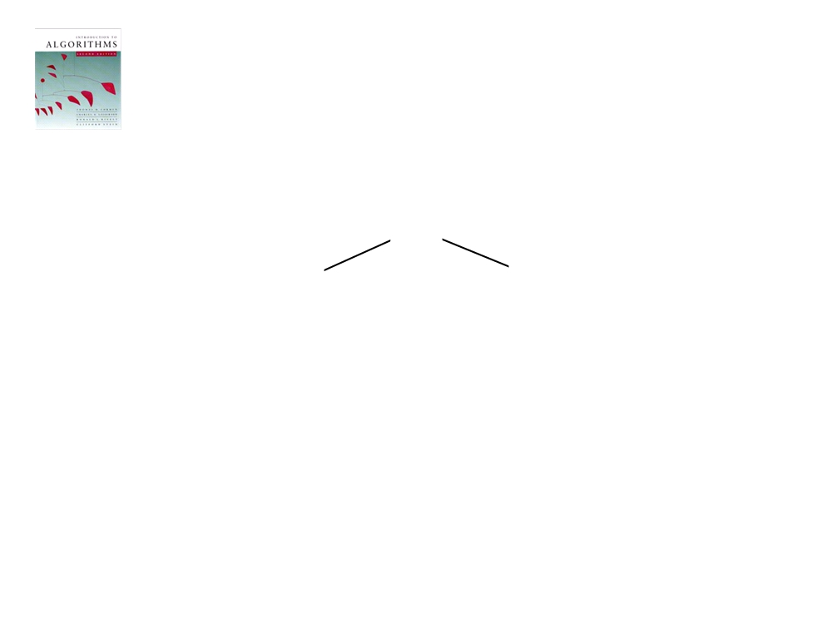
Recursion tree
Solve T(n) = 2T(n/2) + cn, where c > 0 is constant.
cn
T(n/2)
T(n/2)
feb 13, 2012
Introduction to Algorithms
L1.43

Slide 44
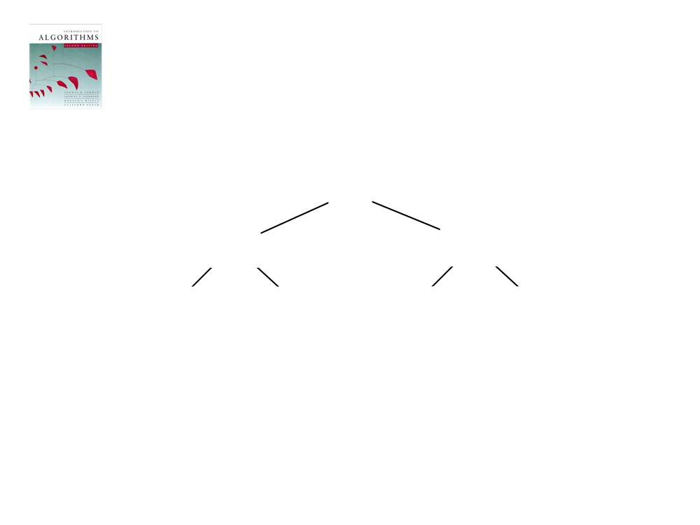
Recursion tree
Solve T(n) = 2T(n/2) + cn, where c > 0 is constant.
cn
cn/2
cn/2
T(n/4)
T(n/4)
T(n/4)
T(n/4)
feb 13, 2012
Introduction to Algorithms
L1.44

Slide 45
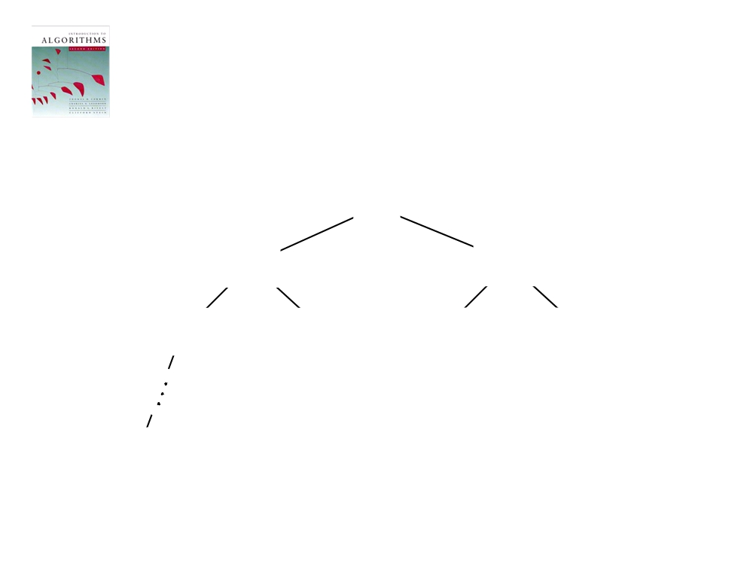
Recursion tree
Solve T(n) = 2T(n/2) + cn, where c > 0 is constant.
cn
cn/2
cn/2
cn/4
cn/4
cn/4
cn/4
Θ(1)
feb 13, 2012
Introduction to Algorithms
L1.45

Slide 46
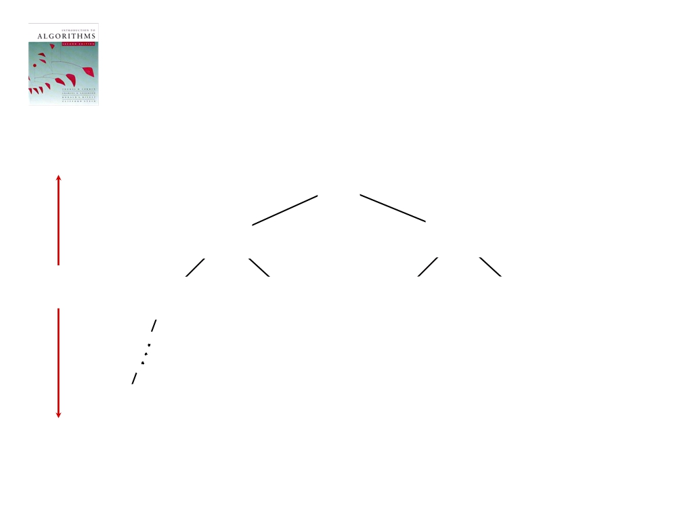
Recursion tree
Solve T(n) = 2T(n/2) + cn, where c > 0 is constant.
cn
cn/2
cn/4
cn/2
cn/4
h = lg n
cn/4 cn/4
Θ(1)
feb 13, 2012
Introduction to Algorithms
L1.46

Slide 47
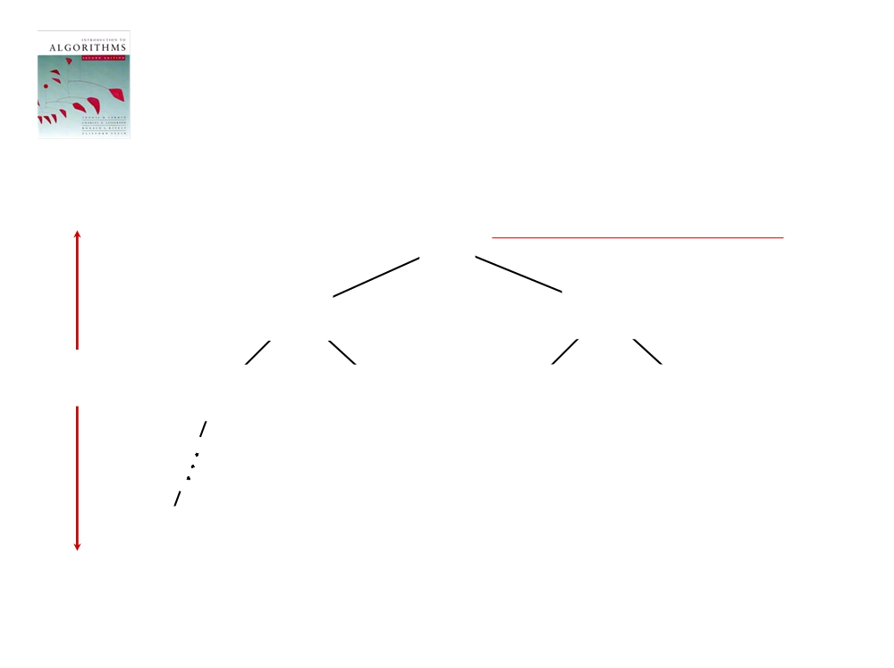
Recursion tree
Solve T(n) = 2T(n/2) + cn, where c > 0 is constant.
cn
cn
cn/2
cn/4
cn/2
cn/4
h = lg n
cn/4 cn/4
Θ(1)
feb 13, 2012
Introduction to Algorithms
L1.47

Slide 48
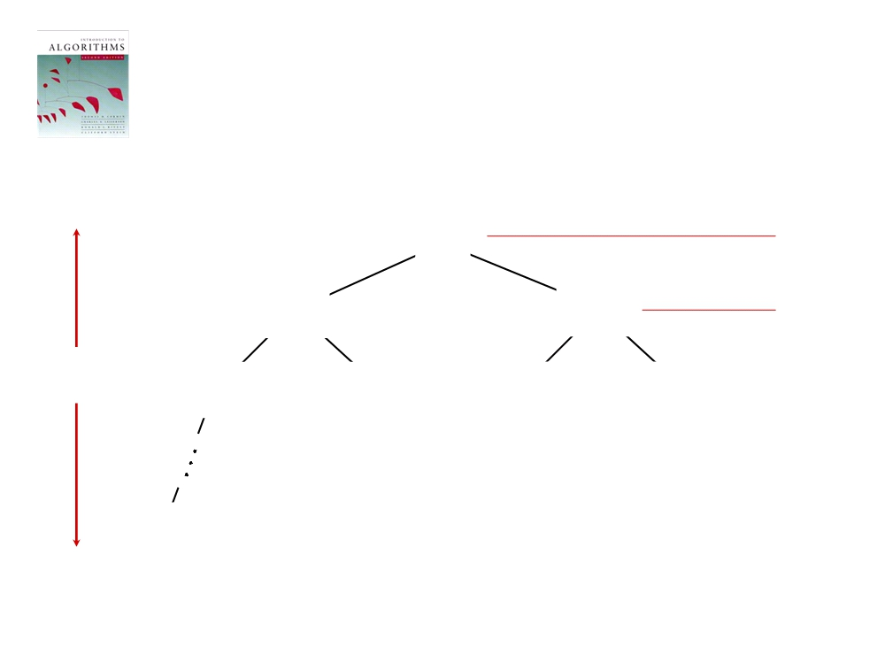
Recursion tree
Solve T(n) = 2T(n/2) + cn, where c > 0 is constant.
cn
cn
cn/2
cn/4
cn/2 cn
h = lg n
cn/4 cn/4
cn/4
Θ(1)
feb 13, 2012
Introduction to Algorithms
L1.48

Slide 49

Recursion tree
Solve T(n) = 2T(n/2) + cn, where c > 0 is constant.
cn
cn
cn/2
cn/4
cn/2 cn
h = lg n
cn/4 cn/4
cn/4 cn
Θ(1)
feb 13, 2012
Introduction to Algorithms
L1.49

Slide 50
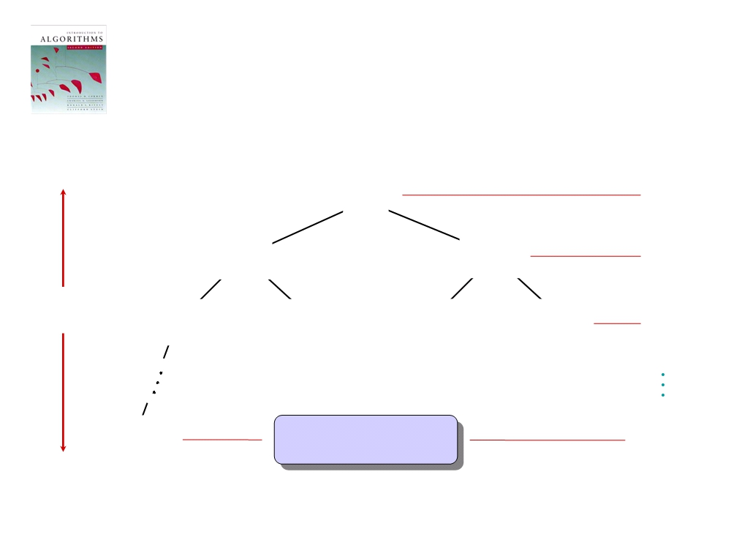
Recursion tree
Solve T(n) = 2T(n/2) + cn, where c > 0 is constant.
cn
cn
cn/2
cn/4
cn/2 cn
h = lg n
cn/4 cn /4
cn/4 cn
Θ(1)
#leaves = n
Θ(n)
feb 13, 2012
Introduction to Algorithms
L1.50

Slide 51
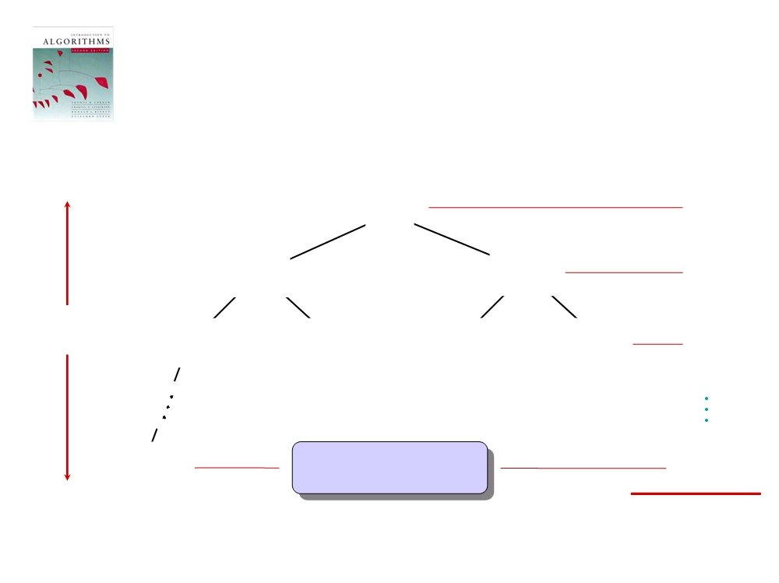
Recursion tree
Solve T(n) = 2T(n/2) + cn, where c > 0 is constant.
cn
cn
cn/2
cn/4
cn/2 cn
h = lg n
cn/4 cn /4
cn/4 cn
Θ(1)
#leaves = n
Θ(n)
Total = Θ(n lg n)
feb 13, 2012
Introduction to Algorithms
L1.51

Slide 52
Conclusions
• Θ(n lg n) grows more slowly than Θ(n²).
• Therefore, merge sort asymptotically
beats insertion sort in the worst case.
• In practice, merge sort beats insertion
sort for n > 30 or so.
• Go test it out for yourself!
feb 13, 2012
Introduction to Algorithms
L1.52

Slide 53
Sequential search
•Problem: Is the key x in the array S of n keys?
Inputs (parameters): positive integer n, array of keys
S indexed from 1 to n, and a key x.
Outputs: location, the location of x in S (0 if x is not in S.)
void seqsearch(int n, const keytype S [ ],
keytype x, index & location)
{ location = 1;
while (location <= n && S[location] != x)
location ++;
if (location > n)
location=0;
}
feb 13, 2012
Introduction to Algorithms
L1.52

Slide 54
Add Array Members
• Problem: Add all the numbers in the array S of n numbers.
Inputs: positive integer n, array of numbers S
indexed from 1 to n.
Outputs: sum, the sum of the numbers in S.
number sum (int n, const number S[ ])
{ index i;
number result;
result = 0;
for (i = 1; i <= n; i++)
result = result + S[i];
return result;
}
feb 13, 2012
Introduction to Algorithms
L1.52

Slide 55
Exchange Sort
• Problem:Sort n keys in nondecreasing order.
Inputs: positive integer n, array of keys S indexed from 1 to n..
Outputs: the array S containing the keys in
nondecreasing order.
void exchangesort (int n, keytype S[])
{ index i, j;
for (i=1;i<= n; i++)
for (j=i+l; j<= n; j++)
if (S[j] < S[i])
exchange S[i] and S[j]; }
feb 13, 2012
Introduction to Algorithms
L1.52

Slide 56
Matrix Multiplication
Problem: Determine the product of two n x n matrices.
Outputs: the product of A and B.
void matrixmult (int n, const number A[][], const number B[][], number C[][])
{ index i, j, k;
for (i=1; j<= n; j++)
for (j=1; j<= n; j++)
{ C[ i ] [ j ] = 0;
for (k=1; k<= n; k++)
C[ i ] [ j ] = C[ i ] [ j ] + A [ i ] [ k ] * B [ k ] [ j ];
}
}
feb 13, 2012
Introduction to Algorithms
L1.52

Slide 57
Sequential Search Versus Binary Search
void binsearch(int n, const keytype S[], keytype x, index& location)
{
index low, high, mid;
low = 1; high = n; location = 0;
while (low < = high && location = = 0)
{
mid = ∟(low + high)/2⌋;
if (x = = S[mid])
location = mid;
else if (x < S[ mid ])
high = mid - 1;
else
Low = mid + 1;
}
}
feb 13, 2012
Introduction to Algorithms
L1.52

Slide 58
Sequential Search Versus Binary Search
Array Size | Number of Comparisons by Sequential Search | Number of Comparisons by Binary Search
128 | 128 | 8
1,024 | 1,024 | 11
1,048,576 | 1,048,576 | 21
4, 294, 967, 296 | 4, 294, 967, 296 | 33
feb 13, 2012
Introduction to Algorithms
L1.52

Slide 59
The Fibonacci Sequence
F0=0
F1=1
Fn=Fn-1+Fn-2 where n>1
F2= F1+F0
F3= F2+F1
int fib (int n)
{
if (n <= 1)
return n;
else
return fib (n - 1) + fib (n-2);
}
feb 13, 2012
Introduction to Algorithms
L1.52

Slide 60
The Fibonacci Sequence
n | Number of Terms Computed
0 | 1
1 | 1
2 | 3
3 | 5
4 | 9
5 | 15
6 | 25
feb 13, 2012
Introduction to Algorithms
L1.52

Slide 61
The Fibonacci Sequence
Show recursion Tree from the e book
Not like binary search tree
We can not determine the number of nodes in it
but from previous table
T(n)>2 * T(n-2)
>2*2*T(n-4)
>2*2*2*T(n-8)
.
.
>2*2*2*2*2*2....T(0)
n/2 terms
T(0)=1 then T(n) >2^{n/2}
feb 13, 2012
Introduction to Algorithms
L1.52

Slide 62
The Fibonacci Sequence
Proof by induction T(n) >2^{n/2}
int fib 2 (int n)
{ index i;
int f[0 .. n];
f[ 0 ] = 0;
if (n > 0)
{ f[ 1 ] = 1;
for (i = 2; i<= n; i++)
f[ i ] = f[i - 1] + f [i -2 ];
}
return f[ n ];
}
feb 13, 2012
Introduction to Algorithms
L1.52

Slide 63
The Fibonacci Sequence
n | n + 1 | 2^{n/2} | Execution Time A2 | A!
40 | 41 | 1,048,576 | 41 ns[*] | 1048 μs[†]
60 | 61 | 1.l × 1O⁹ | 61 ns | 1 s
80 | 81 | 1.1 × 10¹² | 81 ns | 18 min
100 | 101 | 1.1 × 10¹⁵ | 101 ns | 13 days
120 | 121 | 1.2 × 10¹⁸ | 121 ns | 36 years
160 | 161 | 1.2 × 10²⁴ | 161 ns | 3.8 × 10⁷ years
200 | 201 | 1.3 × 10³⁰ | 201 ns | 4 × 10¹³ years
feb 13, 2012
Introduction to Algorithms
L1.52

Slide 64
Every-Case time complexity
Every-Case Time Complexity (Add Array Members) T(n) = n
Every−Case Time Complexity (Exchange Sort)
T(n)=(n-1) +(n-2)+…..+1=(n-1)n/2
Every-Case Time Complexity (Matrix Multiplication)
T(n)=n*n*n =n³
feb 13, 2012
Introduction to Algorithms
L1.52

Slide 65
Every-Case time complexity
Every-Case Time Complexity (Add Array Members) T(n) = n
Every−Case Time Complexity (Exchange Sort)
T(n)=(n-1) +(n-2)+…..+1=(n-1)n/2
Every-Case Time Complexity (Matrix Multiplication)
T(n)=n*n*n =n³
feb 13, 2012
Introduction to Algorithms
L1.52

Slide 66
What if algorithm not have an Every-Case time complexity
The basic operation on Sequential search algorithm is not done the same number of times for all instances of size n
feb 13, 2012
Introduction to Algorithms
L1.52

Slide 67
Worst−Case Time Complexity (Sequential Search)
The basic operation is done at most n times, which is the case if x is the last item in the array or if x is not in the array. Therefore
W(n)=n
the worst-case analysis informs us of the absolute maximum amount of time consumed
A(n) is defined as the average (expected value) of the number of times the algorithm does the basic operation for an input size of n
feb 13, 2012
Introduction to Algorithms
L1.52

Slide 68
Average-Case Time Complexity (Sequential Search)
for 1 ≤ k ≤ n, the probability that x is in the kth array slot is 1/n. If x is in the kth array slot, the number of times the basic operation is done to locate x is k. This means that the average time complexity is given by
Sum from k=1 to n (k* 1/n)=1/n*(n*(n+1)/2 =(n+1)/2
If x is not in array p probability if found and (1-p) if not.
feb 13, 2012
Introduction to Algorithms
L1.52

Slide 69
Best-Case Time Complexity (sequential Search)
Because n ≥ 1, there must be at least one pass through the loop, If x = S[1], there will be one pass through the loop regardless of the size of n. Therefore,
B(n)=1
complexity function can be any function that maps the positive integers to the nonnegative reals. When not referring to the time complexity or memory complexity for some particular algorithm, we will usually use standard function notation, such as f(n) and g(n), to represent complexity functions. Like f(n) =n or f(n) = n²
feb 13, 2012
Introduction to Algorithms
L1.52

Slide 70
Applying the Theory
Suppose we have two algorithms for the same problem with the following every-case time complexities: n for the first algorithm and n² for the second algorithm. The first algorithm appears more efficient. Suppose, however, a given computer takes 1,000 times as long to process the basic operation once in the first algorithm as it takes to process the basic operation once in the second algorithm. By "process" we mean that we are including the time it takes to execute the control instructions. Therefore, if t is the time required to process the basic operation once in the second algorithm, 1,000t is the time required to process the basic operation once in the first algorithm.
This means the times it takes the computer to process an instance of size n are n × 1,000t for the first algorithm and
n² × t for the second algorithm. We must solve the following inequality to determine when the first algorithm is more efficient:
n²*t >n*1000t div by nt n >1000
feb 13, 2012
Introduction to Algorithms
L1.52

Slide 71
Order
We just illustrated that an algorithm with a time complexity of n is more efficient than one with a time complexity of n²
every-case time complexities are 100n for the first algorithm and 0.01n² for the second algorithm.
the first algorithm will be more efficient if
0.01n² > 100n
There is a fundamental principle here. That is, any linear-time algorithm is eventually more efficient than any quadratic-time algorithm. Next we will show how algorithms can be grouped according to their eventual behavior. In this way we can readily determine whether one algorithm's eventual behavior is better than another's
feb 13, 2012
Introduction to Algorithms
L1.52

Slide 72
Order
Functions such as 5n² and 5n² + 100 are called pure quadratic functions because they contain no linear term
whereas a function such as 0. 1n² + n + 100 is called a complete quadratic function becanse it contains a linear term
Next table shows that eventually the quadratic term dominates this function That is, the values of the other terms eventually become insignificant compared with the value of the quadratic term
Therefore, although the function is not a pure quadratic function, we can classify it with the pure quadratic functions
n | 0.1n² | 0.1n² + n + 100
10 | 10 | 120
20 | 40 | 160
50 | 250 | 400
100 | 1,000 | 1,200
1,000 | 100,000 | 101,100
feb 13, 2012
Introduction to Algorithms
L1.52

Slide 73
Order
The set of all complexity functions that can be classified with pure quadratic functions is called Θ(n²), where Θ is the Greek capital letter "theta." If a function is a member of the set Θ(n²), we say that the function is order of n². For example, because we can throw away low-order terms
g(n)=5n² + 100n +20 Ɛ Θ(n²)
Most common categories
Θ(lgn) , Θ(n) , Θ(nlgn) , Θ(n²) , Θ(n³) , Θ(2^{n})
feb 13, 2012
Introduction to Algorithms
L1.52

Slide 74
Order
For a given complexity function f(n), O(f(n)) is the set of complexity functions g(n) for which there exists some positive real constant c and some nonnegative integer N such that for all n ≤ N,
feb 13, 2012
Introduction to Algorithms
L1.52

